Slide 1
PROJECT 3
Exploratory Data Analysis (EDA) for Real Estate Pricing: Unveiling the Dynamics of House Valuation in a Dynamic Market
- By Deepali Daulat Chaugule

Slide 2
Introduction to the Project
This project involves analyzing housing data to identify key factors that affect house prices. Using various data cleaning, exploratory data analysis, and feature engineering techniques, we aim to extract valuable insights that can aid in decision-making for pricing, investment, and marketing.

Slide 3
Objectives of the Project
The main objectives of this project include:
- Understanding the distribution of house prices
- Identifying influential features affecting price
- Generating actionable insights for real estate stakeholders.

Slide 4
Flow Chart of Operations
Steps involved:
Import Required Libraries
Load the Dataset
Data Cleaning
Univariate Analysis
Multivariate Analysis
Feature Engineering
Feature Engineering and Size Impact
Market Trends Analysis
Customer Preferences Analysis
Summary

Slide 5
Python Codes
Code snippets for key steps in data handling:
- Data loading and preview
- Data cleaning for missing values
- EDA and Feature Engineering
Refer to Project_3.py for detailed code.

Slide 6
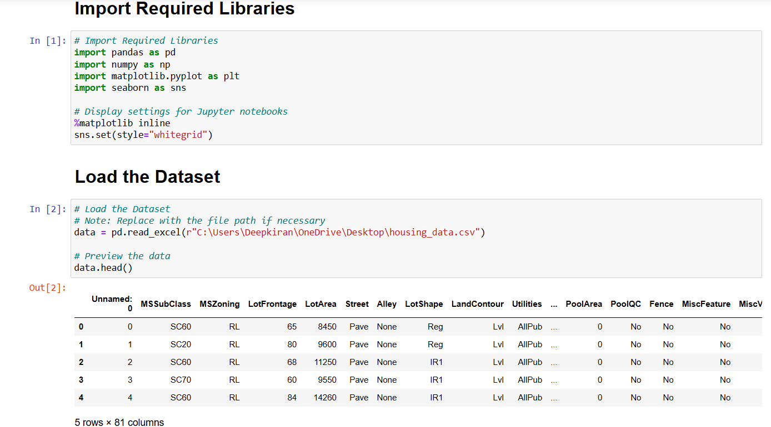
Screenshot of the Outputs
Sample outputs from data checks and cleaning, e.g., data information, missing values after cleaning.

Slide 7
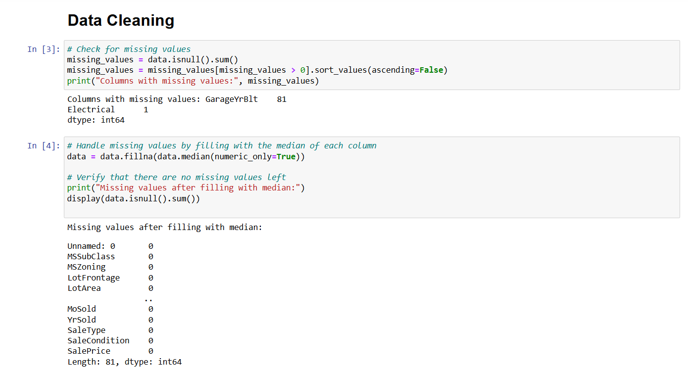

Slide 8
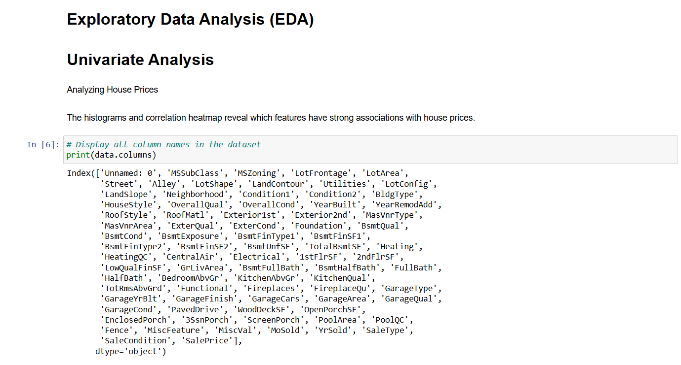
Report on EDA (Exploratory Data Analysis)
Key EDA insights:
- House price distribution (Histogram)
- Correlation Heatmap
- Box plots for Bedrooms, Kitchens, Bathrooms
Visuals such as distribution and box plots are attached to give insights into price influencers.

Slide 9
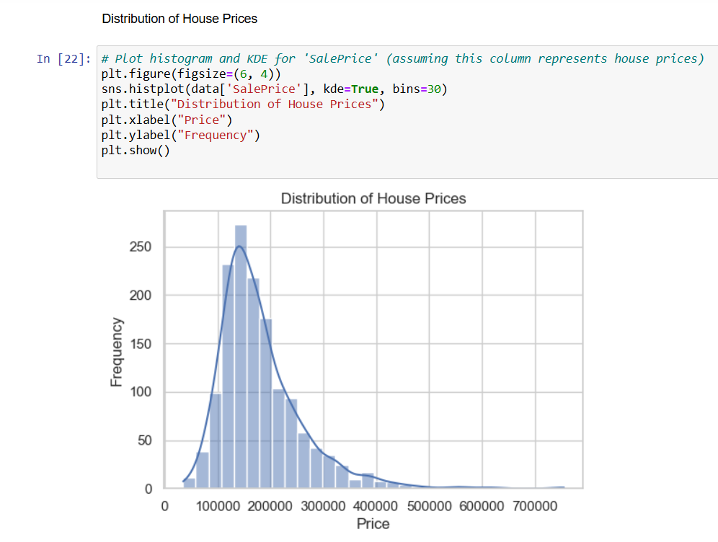
Distribution of House Prices

Slide 10
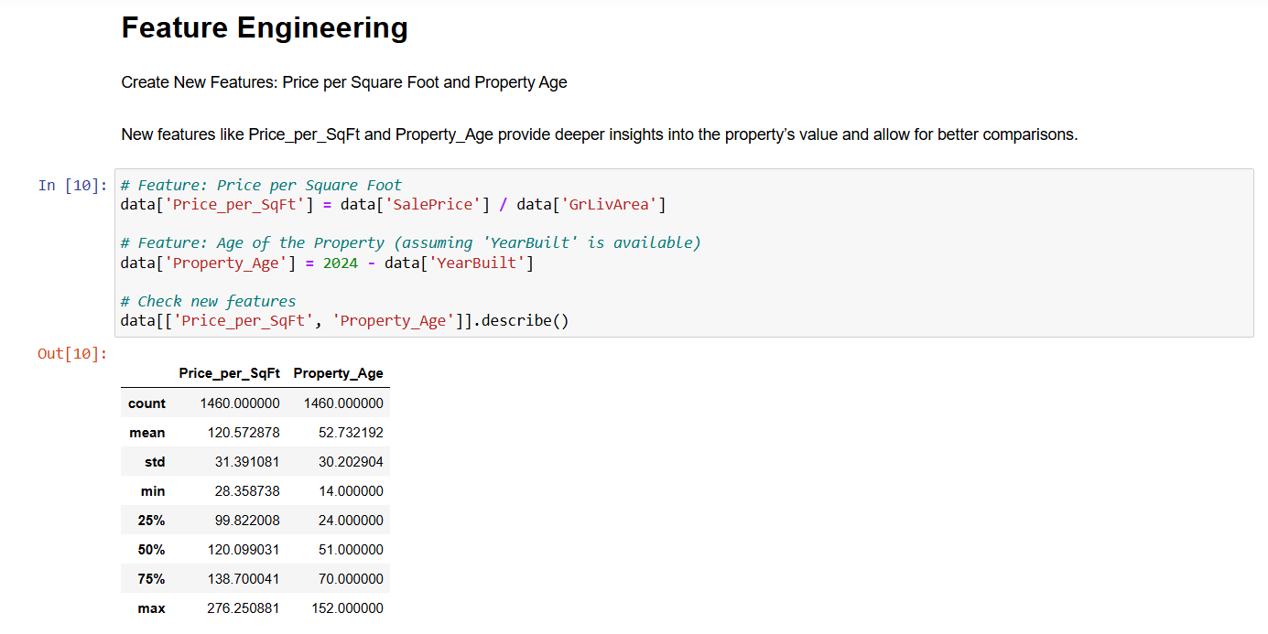
Feature Engineering

Slide 11
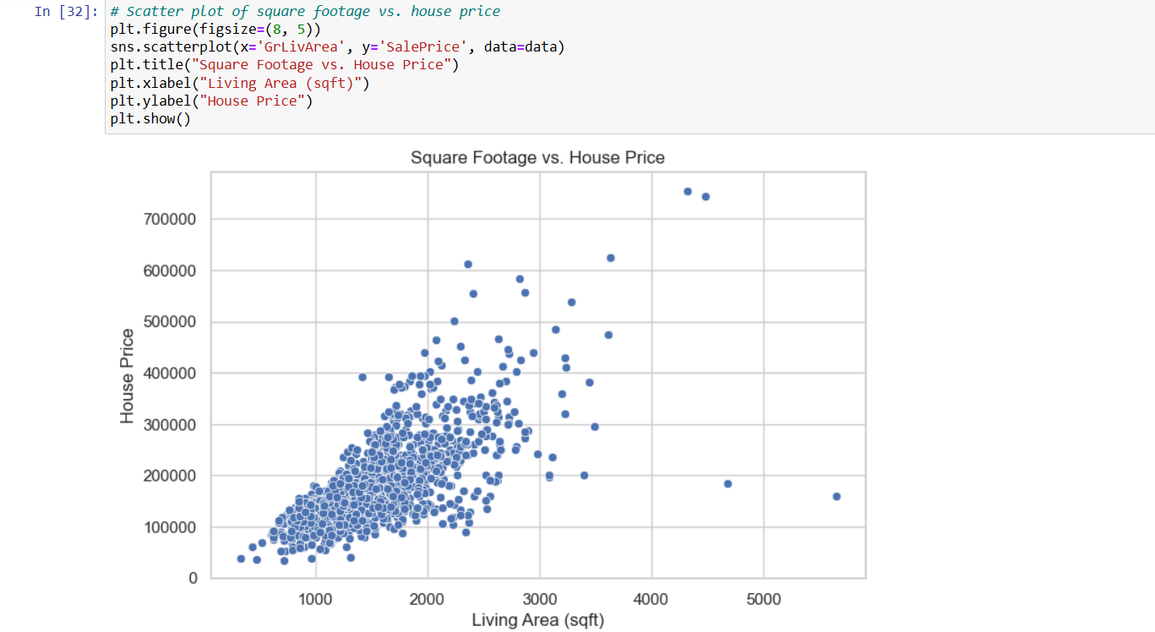
Feature Engineering and Size Impact

Slide 12
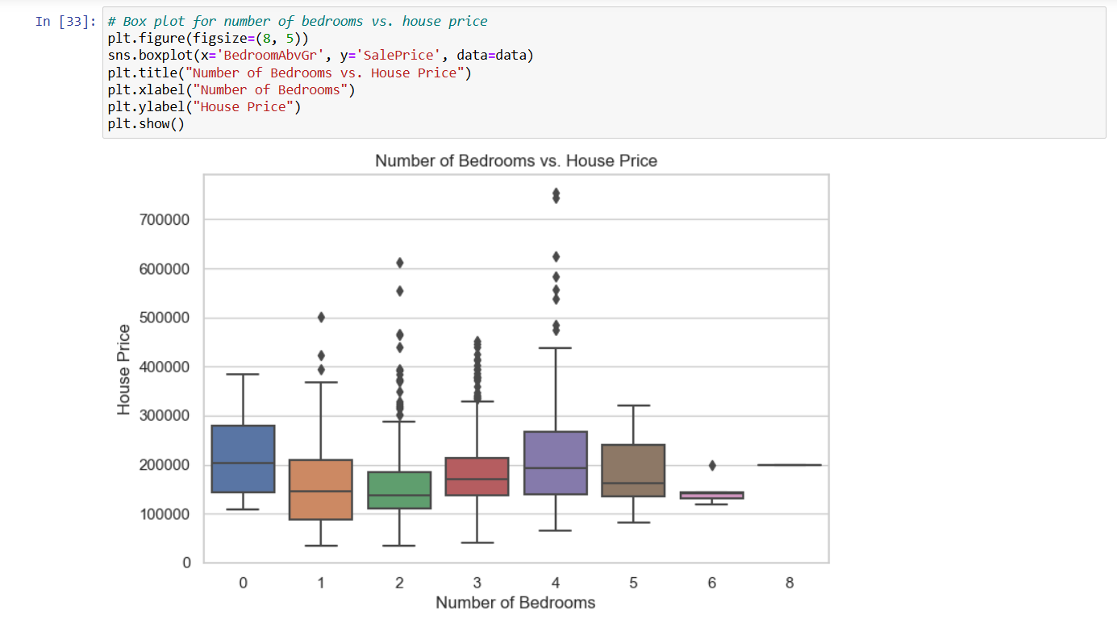
Feature Engineering and Size Impact

Slide 13
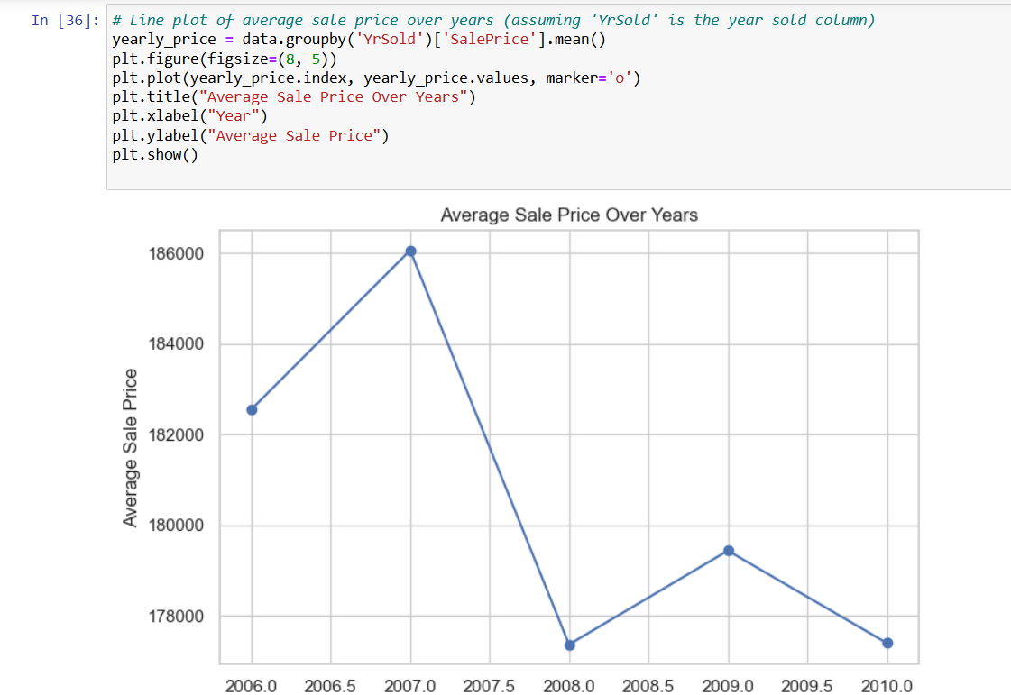
Market Trend Analysis

Slide 14
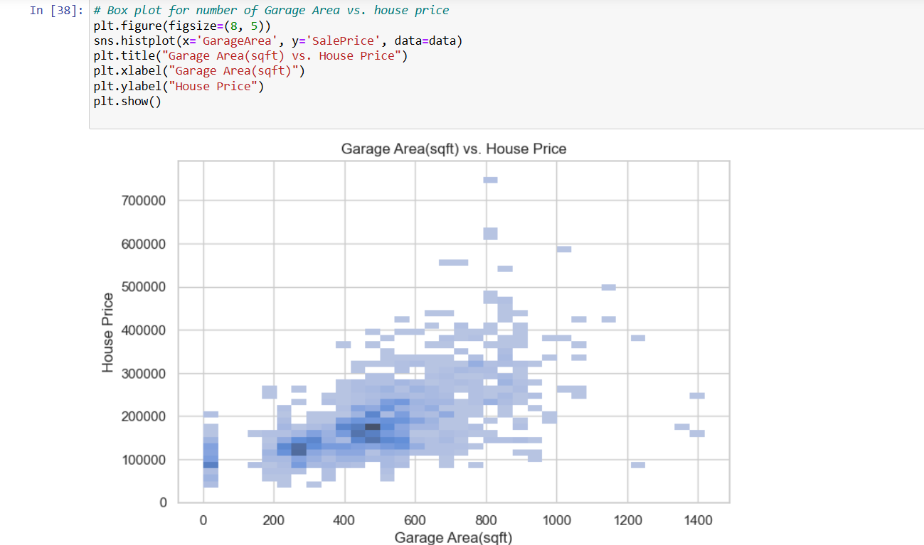
Customer Preferences Analysis

Slide 15
Learning Outcomes
From this project, we learned:
- The significance of specific features (e.g., square footage, bedrooms) on house pricing.
- The role of feature engineering in enhancing insights, such as creating age and price-per-square-foot features.
- How customer preferences for amenities like swimming pools and garages affect market pricing.

Slide 16
Conclusion
This project successfully provided data-driven insights into factors influencing house prices, helping guide pricing, marketing, and investment decisions for real estate.

Slide 17
Citations – Books and Websites
Resources used:
- Pandas and Seaborn documentation
- Online data science tutorials and statistical resources
- Housing dataset documentation and EDA references

